Slide 1
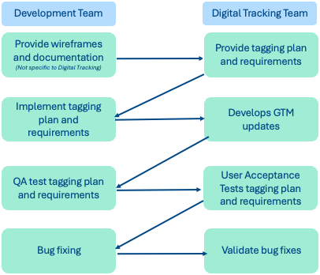
GA4 & GTM Development on New Sites/User Flows

Slide 2
GA4 & GTM Development on New Sites/User Flows
Design Phase
Discovery (est 1 week)
Using wireframes, blocks/modules, variants, actions, project requirements and use cases
Mockup of dashboard to show actionable insights
Tagging plan draft
Requirements gathering session (est 1 day)
Create tagging plan (est 1 week)
Screen shot, with event, dataLayer push, clarify insights gained
Add to JIRA ticket
GA4/GTM Development
Tagging plan review with dev team
When push to dataLayer is complete
Implement on Google Tag Manager
Unit test
Page Design
GA4 Requirements
Tagging Plan
Wireframes
Blocks, modules
Variants, actions
Use cases
Actionable insights needed
Events that need tagging
Code snippets for event
Description of insights gained
Tech Design for Dev
JIRA tickets
Include tagging plan
Link to GA4 JIRA board
Testing plan
Development
Implement push to dataLayer
GTM development
Unit testing
Launch
GA4 tag validation in UAT
launch
GA4 tag validation in prod
©2024 Girl Scouts of the USA. All Rights Reserved. Not for public distribution.
2

Slide 3
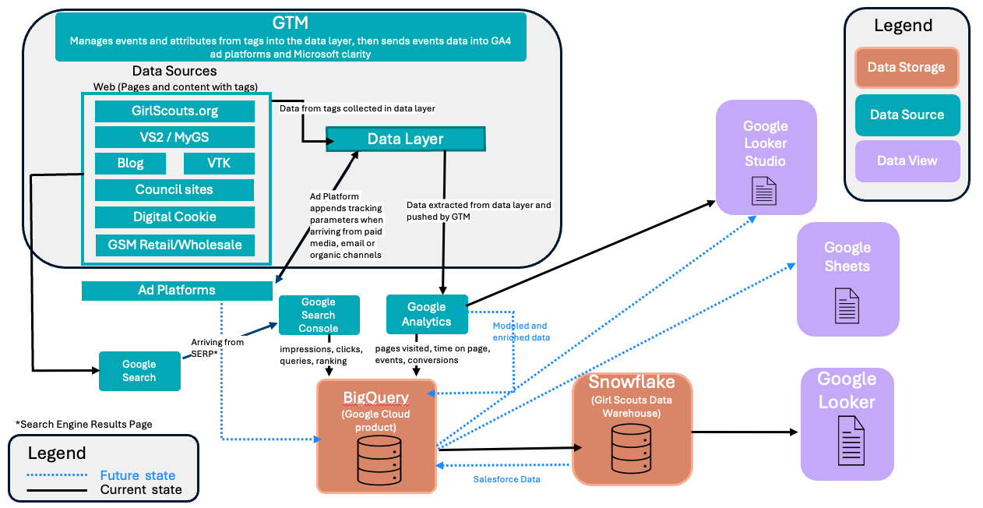
Google Tag Manager (GTM) is at the Center
The website pushes structured data into an object called dataLayer, and Google Tag Manager listens for those pushes to trigger tags that send data to analytics and marketing platforms – without hardcoding each tool into the site.
Why is this architecture so powerful?
Development team owns what happened.
Digital Tracking team owns what gets tracked.
Marketing tools are added without code deploys.
Google explicitly recommends a data-layer-first approach, making this the de facto standard.
User Action on the website
Tags Fire (GA4, Ad Platforms)
Website (HTML/JS)
Data Layer (structured data)
Google Tag Manager

Slide 4
Event Tagging
Scenario: Lead Generation -- person fills out form and clicks the Tell Me More button
Step 1: Website Pushes an Event to the Data Layer
This happens in the website code, not GTM. This is called a custom event.
Step 2: GTM Listens for that Event
Inside GTM there is the Trigger.
Type: Custom Event
Event Name: lead_creation
Step 3: Tag Fires using Data Layer Values
This example is for an event tag that is sent to GA4 and Meta.
Tag Configuration
Event Name: lead_creation
Parameters
campaignID -> {{DLV – campaign_id}}
contentType -> {{DLV– content}}
Effectively we get button click > GTM triggers tag > structured event sent to both GA4 and Meta
<button onclick=”leadCreation()">Tell Me More</button>
<script>
function leadCreation() {
window.dataLayer.push({
event: ‘lead_creation',
campaign_id: ‘MY26-fall',
content: ‘MY26-fall-northeast'
});
}
</script>
Trigger fires when:
Event = lead_creation

Slide 5
GTM and Data Layer on Website
Where GTM Lives on a Website
GTM Container Snippet (Installed Once)
This becomes the only tracking code developers usually need to add manually.
What the Data Layer Is (And Why It Exists)
The data layer is a JavaScript array that stores structured information about the page, the user, and actions/events.
Instead of GTM scraping the page, the site tells GTM exactly what happened.
Think of the Data Layer Like This
Each push() is a new message GTM can react to.
<!-- Google Tag Manager -->
<script>
(function(w,d,s,l,i){w[l]=w[l]||[];
w[l].push({'gtm.start': new Date().getTime(),event:'gtm.js'});
var f=d.getElementsByTagName(s)[0],
j=d.createElement(s),dl=l!='dataLayer'?'&l='+l:'';
j.async=true;
j.src='https://www.googletagmanager.com/gtm.js?id='+i+dl;
f.parentNode.insertBefore(j,f);
})(window,document,'script','dataLayer','GTM-XXXXXXX');
</script>
<!-- End Google Tag Manager -->
window.dataLayer = window.dataLayer || [];
dataLayer = [
{ page: 'home', userType: 'guest' },
{ event: 'button_click', buttonName: 'Sign Up' },
{ event: 'purchase', value: 99.99 }
]
dataLayer.push({ event: ”button.click" })

